Slide 1
Sainbury’s – Agentic AI Store Assistant
Accordion | Team 15

Slide 2
Table
of contents
Overview
Methodology & Decision Making Strategy
Process Flow
UI Snapshots & Functionalities
Q&A Capabilities and Technical Highlights

Slide 3
Overview

Slide 4
AI-Powered Store Assistant
Sainsbury's Retail Chain Solution
This presentation covers the AI-powered Store Assistant solution developed for Sainsbury's retail chain. The solution addresses the challenge of fragmented data across multiple sources by unifying structured data (sales, inventory, staffing) with unstructured data (reviews, images, videos) to deliver comprehensive, actionable insights through an AI-powered conversational interface.
Unifying Structured & Unstructured Data for Actionable Store Insights
Built with Azure OpenAI | FastAPI | Streamlit | ChromaDB

Slide 5
Methodology & Strategic Decision-Making
Agentic AI Architecture
Strategic Technology & Decisions
✓ Specialized AI Agents for Focused Intelligence
• Sentiment Analyzer Agent
- Multi-theme customer review analysis
- Customizable weightage system
• Visual Analyzer Agent
- GPT-4-mini/nano for image/video analysis
- Automated alert generation
• Data Agent
- Natural language query interface
- Cross-source insight generation
✓ Modular Design Principles
• Independent agent development
• Easy extensibility for new features
• Maintainable codebase structure
1. ChromaDB for Vector Embeddings
Rationale: Efficient semantic search,
local-first, no external dependencies
2. FastAPI + Streamlit Stack
Rationale: Rapid development, async
performance, clean separation of concerns
The Methodology centers on an Agentic AI architecture where specialized agents handle distinct tasks. This modular approach ensures maintainability and extensibility. Key strategic decisions included choosing Azure OpenAI for cutting-edge AI capabilities, ChromaDB for efficient vector search without external dependencies, and a FastAPI+Streamlit stack for rapid development with production-grade performance. The customizable weightage system provides business flexibility without requiring code changes.

Slide 6
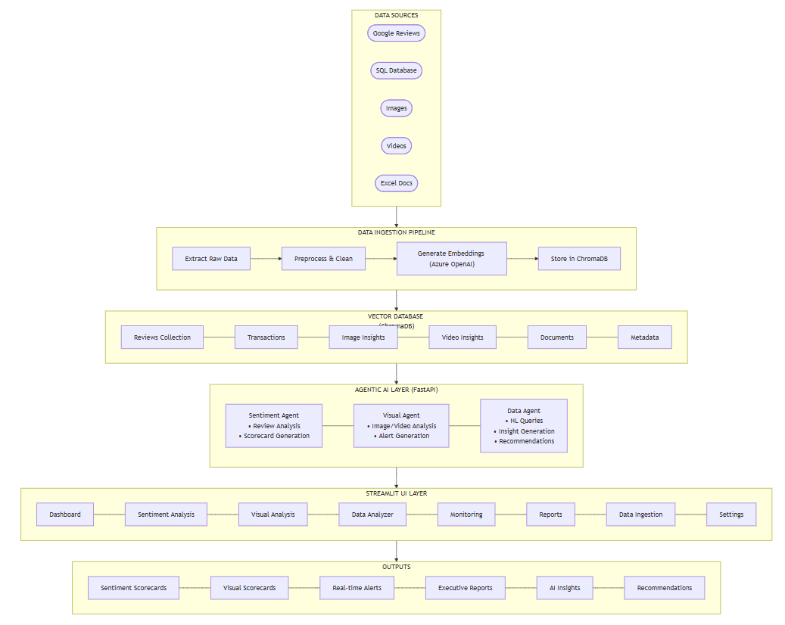
End-to-End Process Flow & Data Pipeline
The process flow begins with multi-source data ingestion from Google Reviews, SQL databases, images, and videos. Data flows through ingestion pipeline where it's extracted, preprocessed, and embedded using Azure OpenAI's embedding model. These embeddings are stored in ChromaDB for efficient semantic search. When a user interacts with the system, the appropriate AI agent (Sentiment, Visual, or Data) is invoked. The agent retrieves relevant context using vector similarity search, processes it through GPT-4-mini/nano, and returns actionable results to the Streamlit UI. This architecture enables responses with complex AI operations across large datasets.

Slide 7
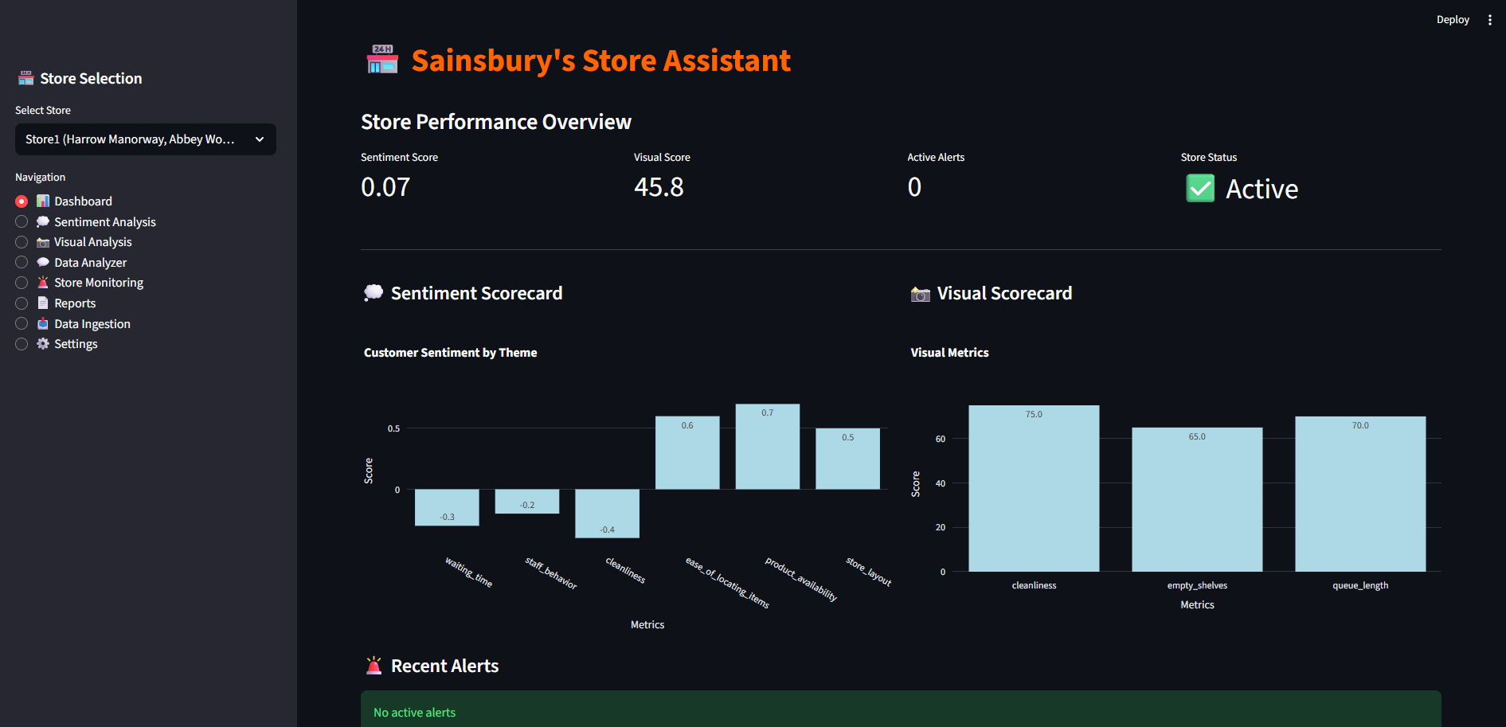
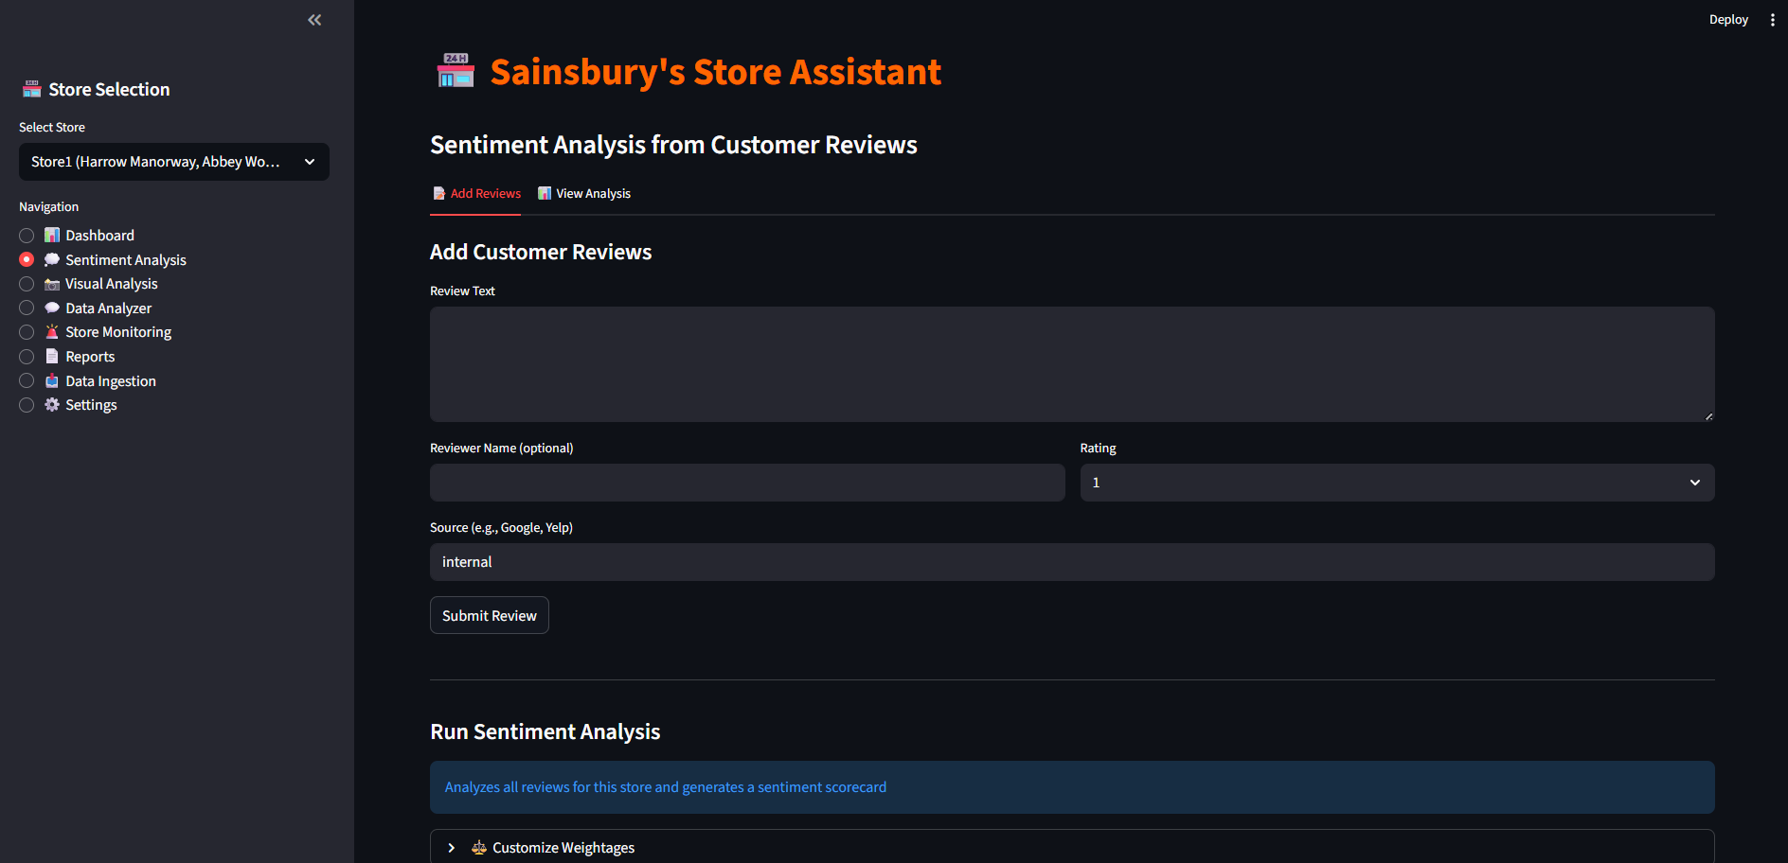
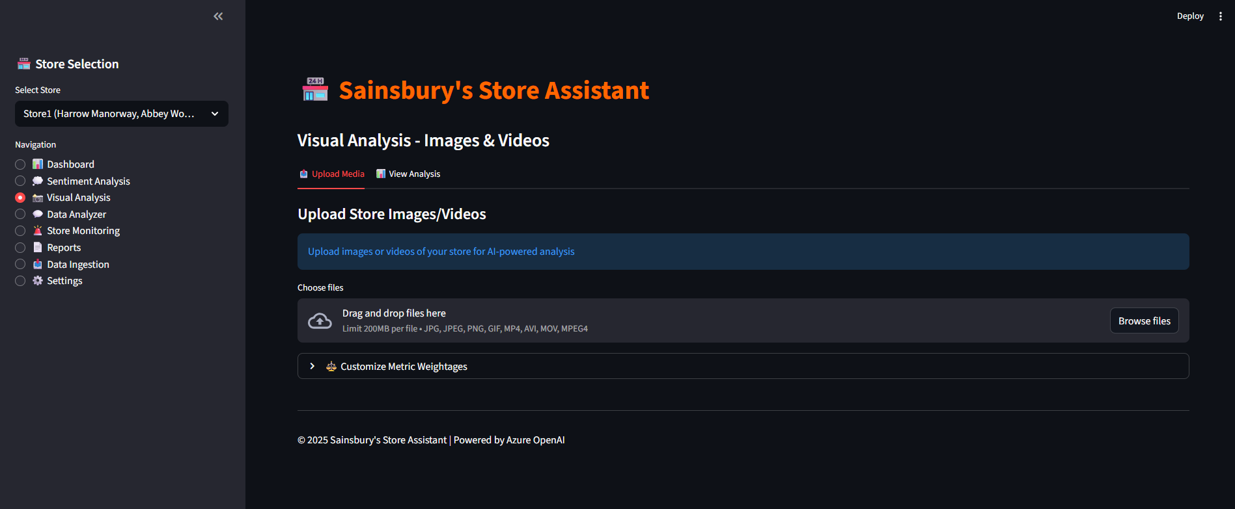
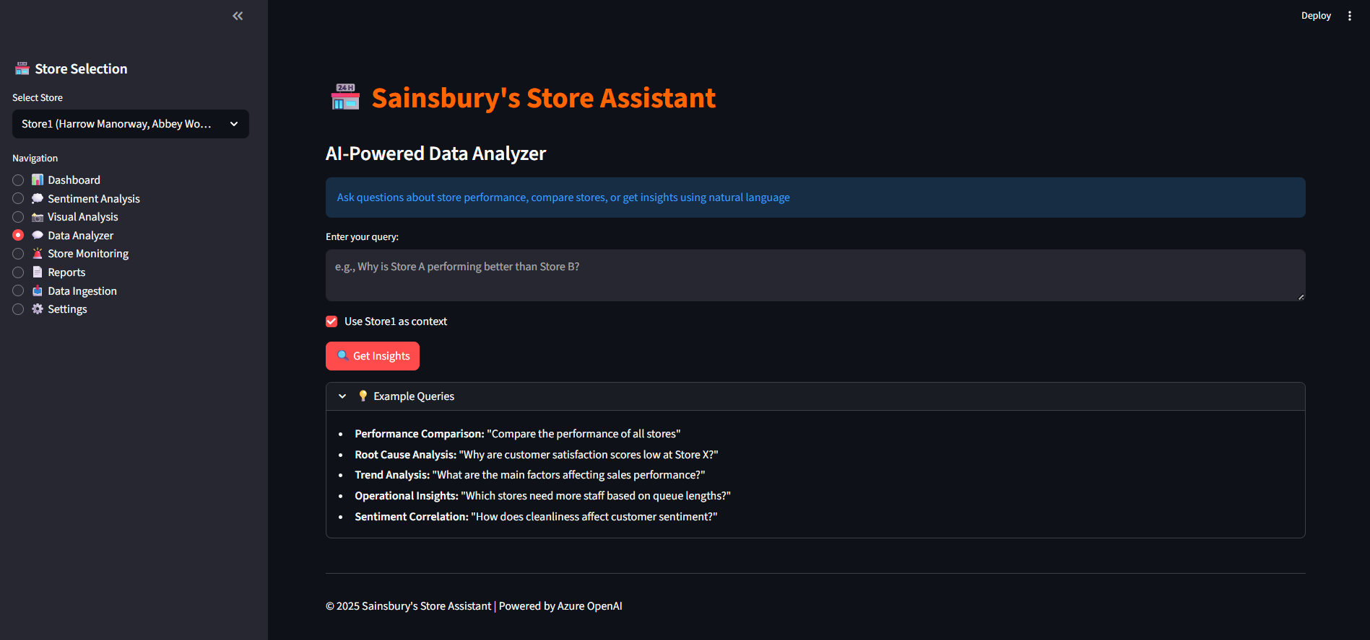
User Interface & Core Functionalities

Slide 8
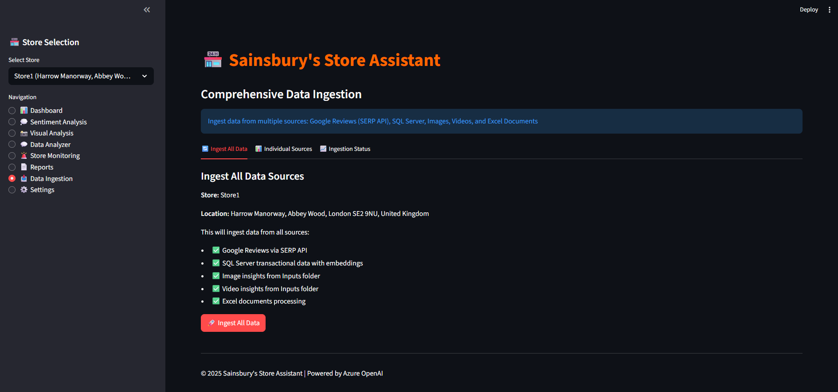
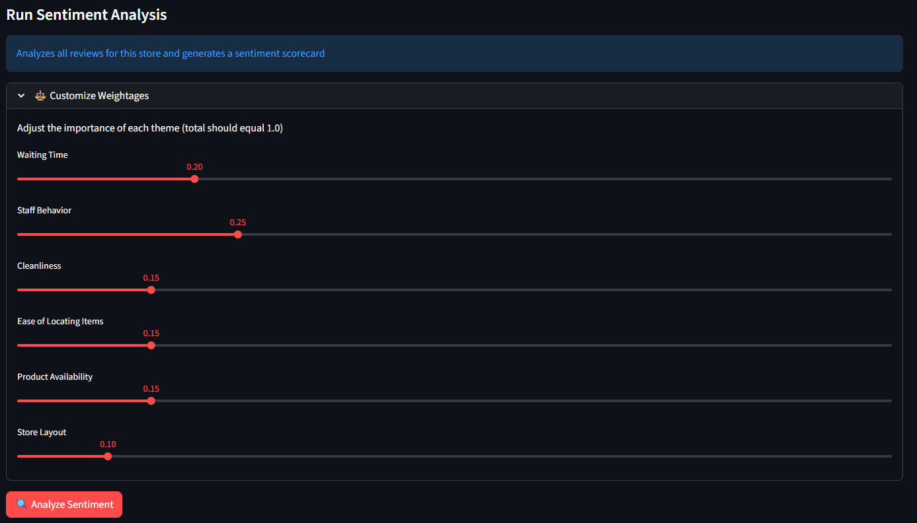
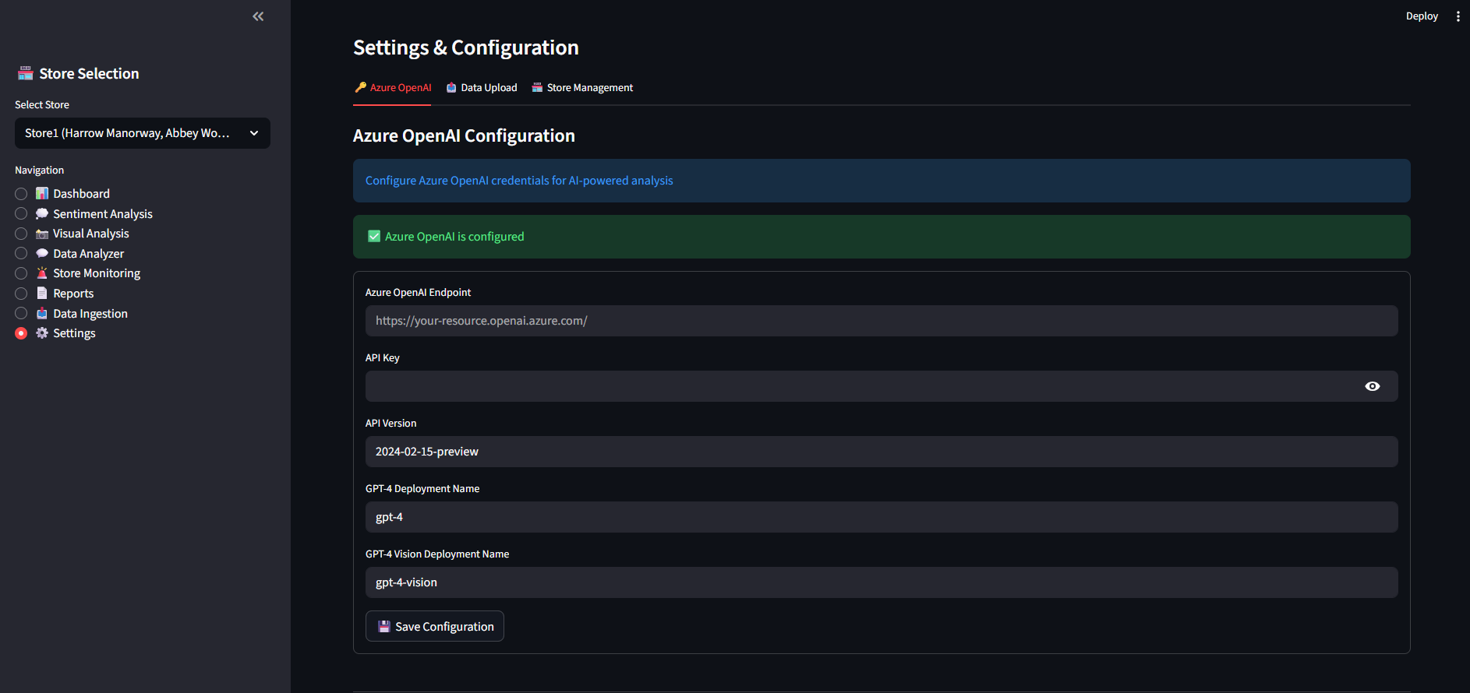
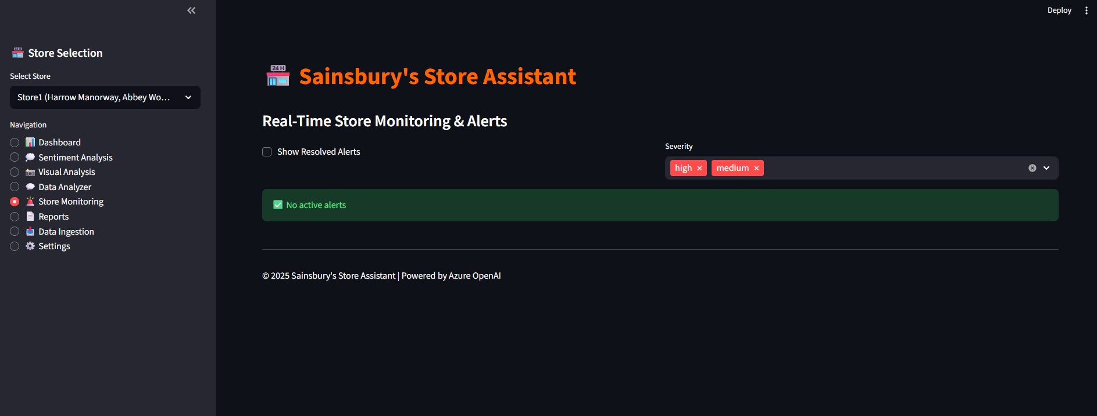

Slide 9
Q&A Capabilities & Technical Excellence
AI-Powered Question Answering
Technical Excellence & Innovation
❓ Example Questions the System Can Answer:
1. "Why is Store A performing better than Store B?"
→ Analyzes sentiment, visual metrics, staffing, sales data; identifies key differentiators
2. "What are the early warning signals for declining performance?"
→ Correlates metrics, identifies patterns, predicts issues before they escalate
3. "Which stores need more staff based on queue lengths?"
→ Analyzes visual data, compares staffing levels, provides specific recommendations
4. "How does cleanliness affect customer sentiment?"
→ Correlates visual cleanliness scores with sentiment themes, shows impact on ratings
5. "What factors most influence sales performance?"
→ Multi-variate analysis across all data sources, weighted importance ranking
🏗️ ARCHITECTURE
• Agentic AI Design Pattern
• Async FastAPI for performance
• Vector embeddings for all data
• Real-time processing pipeline
🤖 AI/ML CAPABILITIES
• GPT for natural language understanding
• GPT for image/video analysis
• Text embedding for vectors
• Context-aware agent reasoning
🔒 DEPLOYMENT-READY
• Comprehensive error handling
• Structured logging throughout
• Mock mode for testing
• Configurable business logic
⚡ PERFORMANCE
• Efficient request handling
• Efficient vector similarity search
• Streaming responses for large data
• Optimized embedding generation

Slide 10
Thank you

